Slide 1
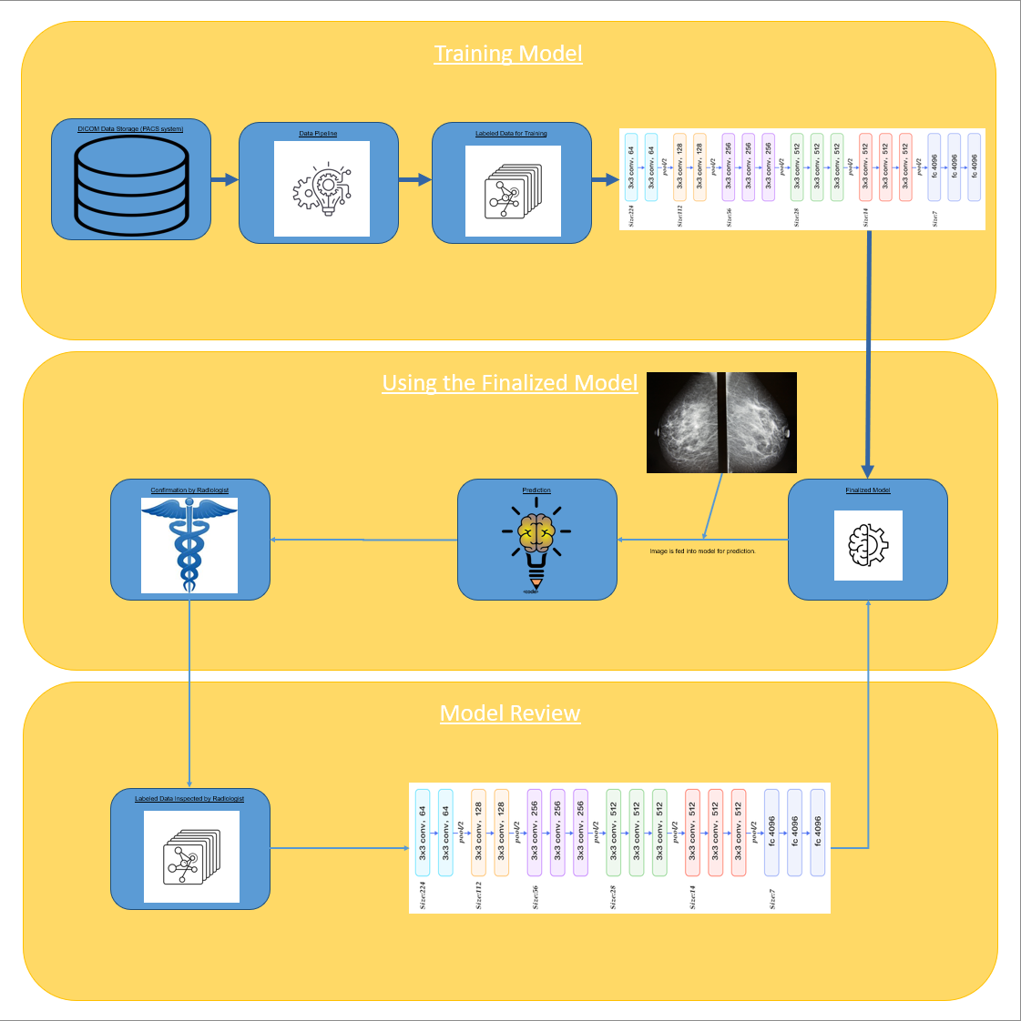
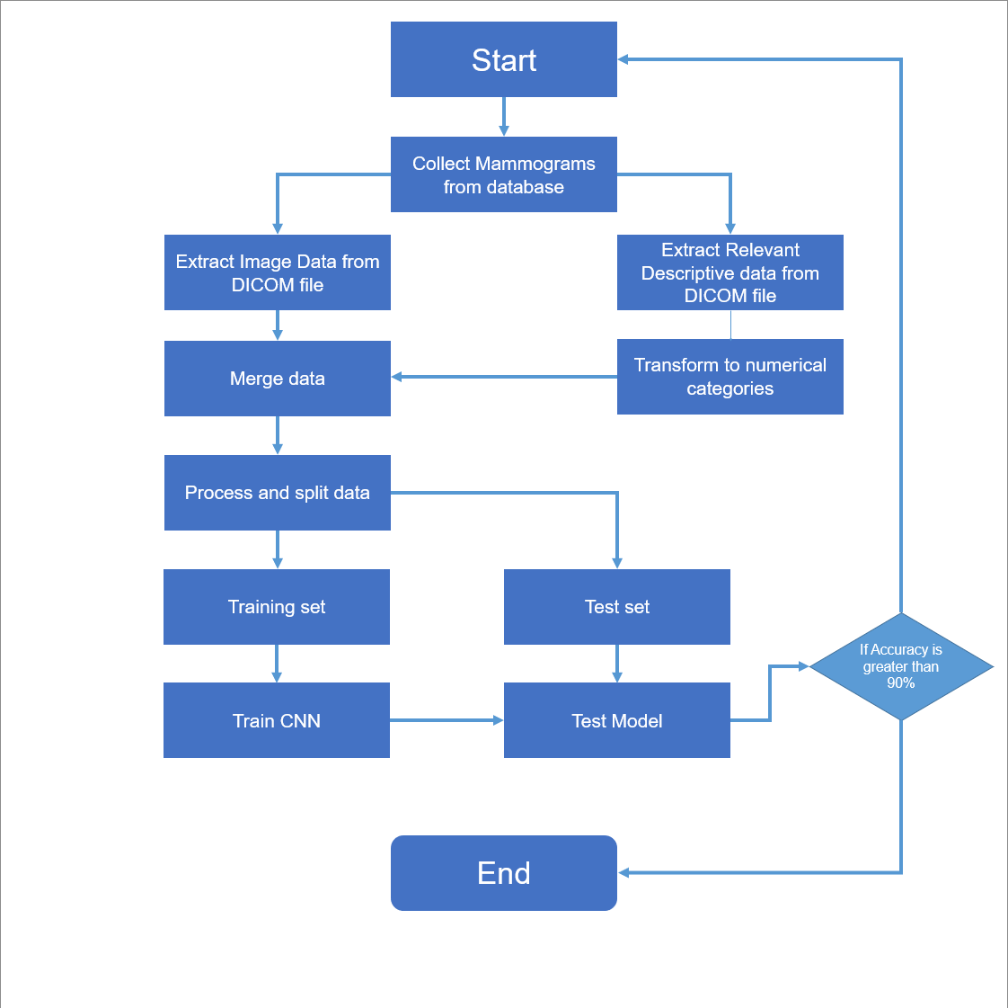

Advisor Name:
Grand Canyon University
The Utilization of Artificial Intelligence to Diagnose Tumors
Wilson B. Peguero Rosario
Context & Background
Use deep learning algorithms to classify DICOM images of possible tumors as benign or malignant
Initial application will be based on retrospective mammograms.
Metadata available will be used to assist the algorithm.
Research Question
Can machine learning algorithms be used to mitigate the demand for radiologists?
Machine Learning Model Flow Chart
Implications
Patient Benefits
Faster Diagnosis
Decrease in misdiagnosis
Overall Benefits
Versatility in Diagnosis (able to diagnose using any modality/ medical history)
Future version may pinpoint tumor for surgical extraction
Materials and Methods
TensorFlow Platform
Dash library for building Dashboards
DICOM data set from TCIA
Model Pipeline
Reference
Can Artificial Intelligence Help See Cancer in New Ways? – NCI
The Role of Artificial Intelligence in Early Cancer Diagnosis - PMC (nih.gov)
The radiologist’s gerbil wheel: interpreting images every 3-4 seconds eight hours a day at Mayo Clinic (appliedradiology.com)
We would like to acknowledge ....
Notes:
Cancer is the second leading cause of death
2/3 of cancer patients declare bankruptcy
Incredibly expensive medicine
False positives can prove dangerous
Radiologists diagnose images every 3-4 seconds
With radiologists diagnosing around 7200 to 9600 images per working day (assuming that the radiologist works for 8 hours a day)
For this reason, a novel machine learning algorithm using the CNN architecture developed by Oxford University called Visual Geometry Group – 16 was created
Named after the group that created the architecture
Submitted for the 2014 ImageNet Challenge

Slide 2


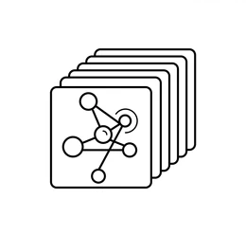
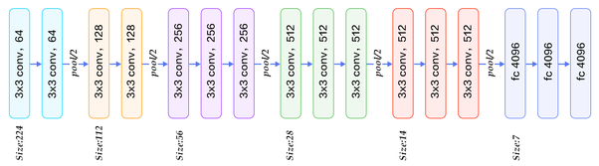
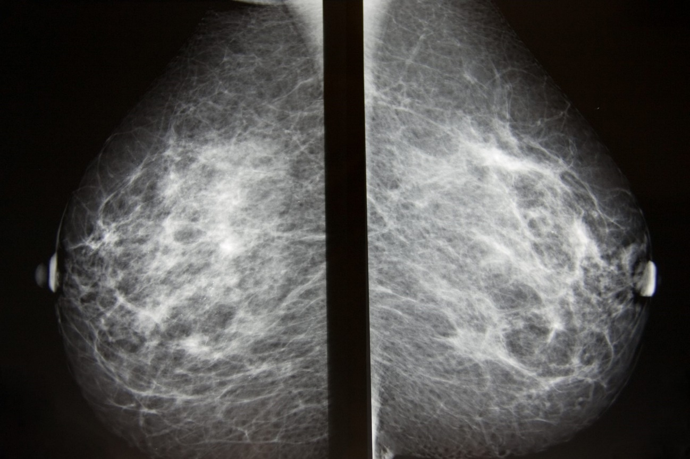
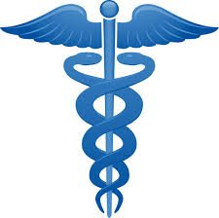


Training Model
DICOM Data Storage (PACS system)
Data Pipeline
Labeled Data for Training
Using the Finalized Model
Confirmation by Radiologist
Prediction
Finalized Model
Image is fed into model for prediction.
Model Review
Labeled Data Inspected by Radiologist
Notes:
Workflow is broken into three part
Initial Training
Use of the model
Model review
Initial Training
Data is extracted from TCIA
Passed through the data pipeline
Labeled data is set up for training the machine learning model
Use of the Model
After testing and validating the accuracy of the machine learning model, the model is ready to use for predictions
The model is used for making predictions
Radiologist validates and cross-examines predictions with near 50-50 probability of malignancy
Model Review
At the end of a predetermined time period, radiologists re-examine all predictions
Radiologist either historically affirm or deny predictions made by model
New data is appropriately labeled
New data is used to further train the machine learning model and improve its ability to accurately make predictions.

Slide 3
Advisor Name:
Grand Canyon University
The Utilization of Artificial Intelligence to Diagnose Tumors
Wilson B. Peguero Rosario
Context & Background
Use deep learning algorithms to classify DICOM images of possible tumors as benign or malignant
Initial application will be based on retrospective mammograms.
Metadata available will be used to assist the algorithm.
Research Question
Can machine learning algorithms be used to mitigate the demand for radiologists?
Machine Learning Model Flow Chart
Implications
Patient Benefits
Faster Diagnosis
Decrease in misdiagnosis
Overall Benefits
Versatility in Diagnosis (able to diagnose using any modality/ medical history)
Future version may pinpoint tumor for surgical extraction
Materials and Methods
TensorFlow Platform
Dash library for building Dashboards
DICOM data set from TCIA
Model Pipeline
Reference
Can Artificial Intelligence Help See Cancer in New Ways? – NCI
The Role of Artificial Intelligence in Early Cancer Diagnosis - PMC (nih.gov)
We would like to acknowledge ....
Notes:
Implications are positive
The current rate of misdiagnosis in breast cancer range from 5% to 28%
With machine learning algorithms, one can reliably diagnose breast tumors with 10% accuracy
Lightening the workload of radiologists
One can begin by using little to no materials
A computer with an RTX 3090TI GPU (a gaming graphics card with similar performance, but less VRAM than the professional AI cards at a fraction of the AI card’s price)
Python and TensorFlow Platform
For machine learning and data wrangling of DICOM files
The Cancer Imaging Archive (TCIA)
Database created by the NIH to contain multitudes of Cancer-related image data

Slide 4
Start
Collect Mammograms from database
Extract Image Data from DICOM file
Extract Relevant Descriptive data from DICOM file
Merge data
Transform to numerical categories
Process and split data
Training set
Test set
If Accuracy is greater than 90%
Train CNN
Test Model
End
Notes:
Another way to observe the process (workflow)

Slide 5


